Slide 1


Creation’s
Shaneh
Part #1
First Tequfah Witness

Slide 2
Creation’s First Tequfah
Who DECLARED the DNA in “Shaneh?”
Genesis 1:14?

Slide 3
Notice: For those new to these studies –
The word – Cycle – is used to designate one 24 hour period, Dawn to Dawn, within a week of 7.
There are 7 - 24 hour cycles in a week.
The word “day” causes too much confusion within its ambiguous inaccuracy.
i.e. Is “day” the light season? Is it the night season or does it reference both?
Cycle - effectively eliminates all this confusion. ☺

Slide 4
Where would one expect to find ULTRA PERTINENT Calendar instructions in a guide for LIFE?
1700 years after an introduction?
(Reference - Joseph’s prophetic dream which is the
1st mention of the moon in the Bible?)
Or at - Creation’s Establishment?

Slide 5
Scripture records in Genesis 1:16 that Yahuah created Two Great Lights.
The word bara (to create) is not seen in cycles 2,3 or 4 during the creation week. This factor exposes that these Two Great Lights were created on
the very first cycle just as it is written! – see Genesis 1:1.
It was on the cycle #4 that these two TWO LUMINARY identities were given their commission to deliver light to the inhabitants that were to live on this earth.
The Sun orb was designed to support life in all living organisms on this earth.
The Mazzaroth reveals its silent story line - THE PLAN OF SALVATION to this earth. The Mazzaroth, historic to future, was designed to provide LIGHT, TIMING, INSTRUCTION, INSPIRATION, HOPE and STRENGTH!

Slide 6
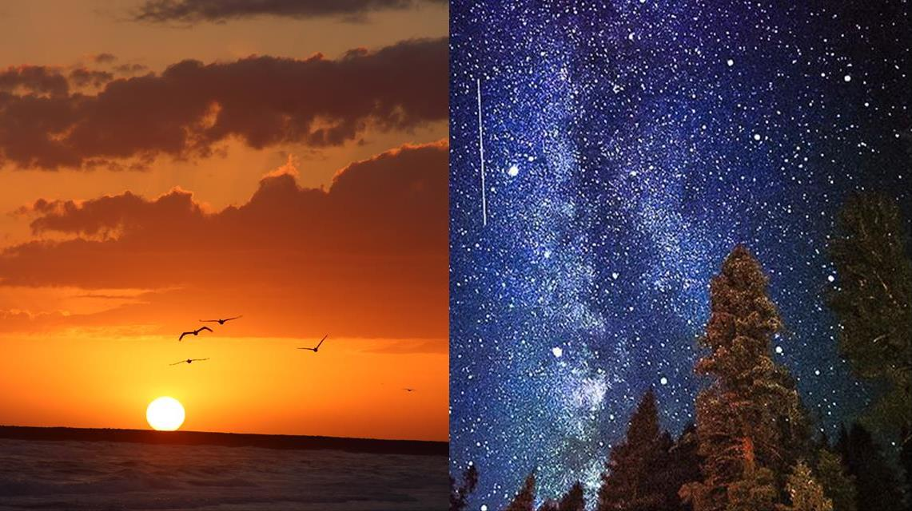
(Ordinances)
Jer 31:35 gives
declaration for
the two great
LIGHT-givers.
The Mazzaroth!
  Thus saith Yahuah, which giveth the sun for a light by day …
  … and of the stars for a light by night …

Slide 7
What does Job reveal about the moon?
See, even the moon does not shine, and the stars have not been flawless in His eyes.
Job 25:5 HalleluYah Scriptures

Slide 8
In the Scriptures, the very first mention of a YEAR is found in Genesis 1:14.
The Hebrew word is H8141- Shaneh.
The reason for looking at this word is to determine if Shaneh has a Lunar or a Tequfah (Equinox) connection for determining Yahuah’s Mo-edim (Feasts.)
1 Cor 14:33 – For Yahuah is NOT THE AUTHOR OF CONFUSION, but of peace as in all churches of the saints.
Is it somehow possible that Yahuah positively identified the design of His worship year RIGHT FROM THE START - Creation?

Slide 9
                Shaneh H8141
                Will the Lunar system of worship exactly reflect the
                Hebrew definitions?
                Will Shaneh exemplify the scriptural Tequfah (Equinox)?
                Which system of worship will fulfill
- through absolute perfection –
                1. Yahuah’s commands
                2. the Torah statutes
                3. the Hebrew word definitions?

Slide 10
                Shaneh H8141
                Is there a Scriptural reference (or two) that links Shaneh with a lunar year? (Is it even possible that someone can find the Scriptural Hebrew word
                that by definition perfectly describes a lunar year!)
                There are two witnesses directly linking Shaneh H8141with the Tequfah!
Exo 34:22 And perform the Festival of Weeks for yourself, of the first-fruits of wheat harvest, and the Festival of Ingathering at the TURN [8622 Tequfah] of the YEAR [H8141 Shaneh]. The Scriptures
Exo 34:22 And thou shalt observe the feast of weeks, of the firstfruits of wheat harvest, and the feast of ingathering at the year's^{H8141} [Shaneh] end [tequfah ^{H8622}]. KJV

Slide 11
                Shaneh H8141
Exo 34:22 Has exposed 2 extremely important elements required of each and every person who decides to honour the commands of Yahuah!
TURN [8622 Tequfah] of the YEAR [H8141 Shaneh].
Any person desiring to observe Yahuah’s Feasts, must indeed upon command, observe them on a Shaneh year format that fully incorporates the function of the Tequfah which ends and starts the year.
ONCE MORE, NOTICE YAHUAH’S BLINDING ABSENCE IN MENTIONING
ANY PHASE WHATSOEVER - OF THE MOON!

Slide 12

                Shaneh H8141
                2nd Witness -
2 Chron 24:23 And it came to pass at the end [H8622 Tequfah] of the year [H8141 Shaneh], that the host of Syria came up against him: and they came to Judah and Jerusalem, and destroyed all the princes of the people from among the people, and sent all the spoil of them unto the King of Damascus.
Wait a minute! The - “END OF THE YEAR”?
Why is there NO lunar phase mentioned here?
Your answer will be thoroughly realized in this study!

Slide 13
                Shaneh H8141
                We have just seen two witnesses that directly link Shaneh with a Tequfah based year.
                Interestingly, that diametrically links Shaneh with Revelation 22:2 and the 12 fruits on the TREE OF LIFE!
                12 Fruits, one for each month!
                Why is there NO FRUIT for a LUNAR 13th month?
                A Clue -
                Isaiah declares we can know the - End - from the Beginning!

Slide 14

With the pagan lunar worship system fully exposed as being under the feet of Yahusha’s Bride (Rev 12:1), let’s investigate this pertinent Hebrew word. This hyper informative word is found first in Genesis 1:14 – translated for us as – YEARS!
                Shaneh H8141
The Gesenius’ Hebrew – Chaldee Lexicon has the definitions of [8141] ה.נ.ש((shaneh) as – of the course of the sun…
of the course of the sun

Slide 15
                Shaneh
                The Gesenius’ Hebrew – Chaldee Lexicon has the definitions of [8141]
                ה.נ.ש((shaneh) as – of the course of the sun,
Let’s view Yahuah’s Scripturally recorded parameters of a circle!
Eccl 1:5 The sun also rises and hurries back to the place where it arose. HalleluYah Scriptures
continued
or of the changes of seasons, as Spring, Summer, Autumn, Winter;
compare the latin annus, WHICH DENOTES A CIRCLE.
360
o

Slide 16
Does the Moon
EVER
return back to its original place of commencement on either 360 or 365 days?

Slide 17
Genesis 1:14 – YEARS! Shaneh
of the course of the sun… -
Point #1 - The sun is NOT A MOON!
Eccl 1:5 makes it clear that a circle starts at one point, travels 360° and returns to the very point of origin. Is there another witness for the sun?
Ps 19:6 Its rising is from one end of the shamayim (heavens),
and its circuit to the other end. HalleluYah Scriptures
Scriptures declare a completed cycle as - point of origin to point of origin!
Does the moon accomplish this task without discrepancy?
or of the changes of seasons, as Spring, Summer, Autumn, Winter; compare the latin annus, which denotes a CIRCLE.

Slide 18
Scripture declares a completed circle as 360 degrees!
We note here that once the sun has completed its full circuit, it is then seen in the same location of the Mazzaroth, from where it once started!
Did Yahuah designate a very specific time of year as the home base or –
POINT OF ORIGIN as a TABERNACLE – (Ps 19:4c) of the sun?
The two points of reckoning are the two Tequfah:
1. Spring Tequfah, and 2. Autumn Tequfah {equinox}!
Ps 19:4 Their line [the Mazzaroth] has gone out through all the
earth, and their words to the end of the world. In them he set up
A TENT [a Tabernacle] FOR THE SUN …
Normally – Mar 20
Normally – Sept 23

Slide 19

It is this ABIB {the greening} point of springtime (tequfah/equinox) when Yahuah told Mosheh it was indeed the first month of the year (H8141)! Mosheh was trained in the wisdom of Egypt with Pharaoh’s intention that Mosheh would one day rule Egypt.
Acts 7:22 And Moses was learned in all the
and was mighty in words and in deeds.
wisdom of the Egyptians,

Slide 20
What? The Egyptians had wisdom?
wisdom of the Egyptians!
I have always been taught that the Egyptians were
all about paganism and full of sin!
Is it possible that the Egyptians were doing something righteous and Yahuah PURPOSELY HAD MOSHEH TRAINED in their type of commerce to later lead Yisra’el in those exact same principles?

Slide 21
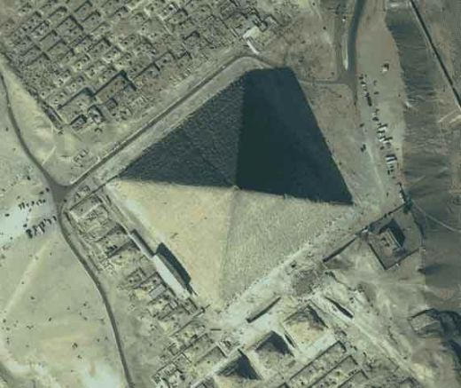
Yahuah insured that Mosheh grew up and was highly trained knowing very clearly that the Great Pyramid of Giza and the Sphynx were both designed with astounding accuracy to demarcate the EXACT day of the Tequfah. We will look at Yahuah speaking with Mosheh later in this study!
ACCURACY is PARAMOUNT!
The Great Pyramid also clearly demarcated the 24 hour cycles immediately prior to,
and following the Tequfah!
A HUGE IMPORTANCE
was emphasized on this guideline for Egypt’s commerce!

Slide 22
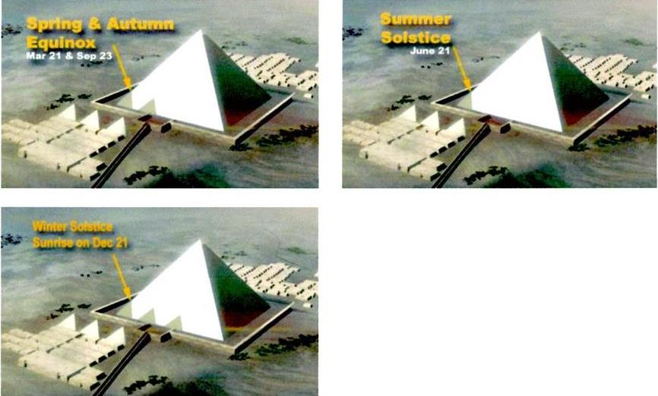
Moses’ wisdom
from
Egypt
Acts 7:22
The design of the pyramids can accurately calculate the equinox’s & solstice's because the movements of the Mazzaroth and the sun are perfect – untouched by any man,
including pagans!

Slide 23
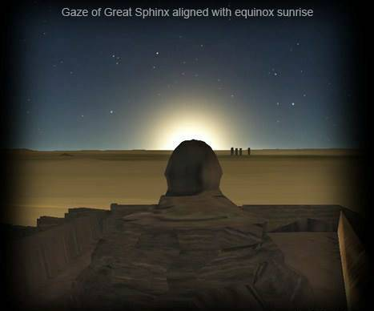
Knowledge TreasurY
of Egypt
The Sphynx which contains the 4 symbols as a representation directing our attention towards Yahuah;
the Ox, Lion, Eagle and a Human.
Ultra important, the Sphynx was designed so when positioned at the tail, on the Tequfah (equinox) the sun arises in perfect alignment directly above the head.
This is nothing less than another marvel of construction in Egypt.

Slide 24
What about the Messianic Testament? (New Testament)
We find a VERY STRONG Tequfah Witness in
Ya’aqov 1:17 (James).
After Yahusha died, His half brother positively identified the Tequfah based Covenant Calendar
as still, and forever, being the calendar of Yahuah!
- NO SHADOW OF TURNING!

Slide 25
NO SHADOW OF TURNING!
When the Tequfah arrives, the shadow created by the Light from the sun shining on an upright marker makes a perfectly straight line!
On the Light Season, before and after the Tequfah
Light Season, that same marker provides for a shadow tracing the path of an ARC across the landscape.
This ARC is specifically reflecting the path of the sun in the sky, from east to west.

Slide 26
Preparation for the next slides!
,,
Sun
Sun
Sun
Sun
Sun
Placing stakes at the tip of the lower arrows will determine the outer limit of the shadow.
The tips of the arrows show the top point of the pole on the ground in the progression of
the sun’s cycle.
Tall pole.
Shadow

Slide 27
Next: James 1:17 –
NO SHADOW OF TURNING!

Slide 28
Ya’aqov 1:17
(James)
G5157- Trope
A DEFINITE SHADOW OF TURNING!
,,
Birds eye view of a vertical 5 meter pole.
The sun appears in the East on the mornings leading up to the Tequfah day.
Sun!
West
The shadow forms an ARC or a CURVED PATH:
it is a - SHADOW OF TURNING - via point to point
by the sun creating the curved shadow.

Slide 29
NO SHADOW OF TURNING!
Birds eye view of a vertical 5 meter pole.
The sun appears in the East at morning and begins the shadow on
,,
Ya’aqov 1:17
(James)
G5157- Trope
THE LIGHT SEASON OF THE TEQUFAH.
Sun!
East
The shadow from the vertical pole does not deviate any direction from a true line across the landscape!
It is a direct, perfectly straight line from point to point!
On a -Tequfah - Light Season, there is -
West
No Shadow of Turning!

Slide 30
G5157- Trope
A DEFINITE SHADOW OF TURNING!
Birds eye view of a vertical 5 meter pole.
The sun appears in the East on the mornings FOLLOWING the Tequfah day. ,,
Sun!
West
The shadow forms an ARC or a CURVED PATH –
a - SHADOW OF TURNING - via point to point
by the sun making the shadow.
I am sorry but I am unable to make this shadow track correctly! ☹

Slide 31
Ya’aqov 1:17
(James)
No Shadow of Turning!
G5157- Trope
Strong’s - G5157
τροπή tropḗ, trop-ay'; from an apparently primary τρέπω trépō to turn; a turn ("trope"), i.e. revolution (figuratively, variation):—turning.
Thayers Greek Lexicon
τροπή, τροπῆς, ἡ (from τρέπω to turn), a turning: of the heavenly bodies, James 1:17 (on this see ἀποσκίασμα); often so in the Greek writings from Homer and Hesiod down (see Liddell and Scott, under the word, 1); cf. Job 38:33 ; Wis. 7:18;
Deuteronomy 33:14; (Sophocles' Lexicon, under the Word).
James 1:17
Job 38:33
Deuteronomy 33:14

Slide 32
Job 38:33
No Shadow of Turning!
Job 38:31 Do you bind the bands of Kimah [Pleiades], or loosen the cords of Kesil [Orion]?
Job 38:32 Do you bring out the constellations [Mazzaroth] in its season? Or do you lead the bear [Arcturas] with its sons?
Job 38:33 Do you know the LAWS OF THE HEAVENS? Or do you set
THEIR RULE OVER THE EARTH?
Jer 33:20 “Thus said יהוה [Yahuah], ‘If you could break My covenant with the day and My covenant with the night, so that there be not day and night in their season …

Slide 33

The Assault on Yahuah’s Covenants
Jer 33:20 “Thus said יהוה, ‘If you could break My covenant with the day and My covenant with the night, SO THAT THERE BE NOT DAY AND NIGHT IN THEIR SEASON,
When man declares the 24 hour period to begin at sunset - …
A Spiritual DISCONNECT is created!

Slide 34
Looking at - Deuteronomy 33:14
Deut 33:14 And for the precious ^{H4022} fruits ^{H8393} brought forth
by the sun, ^{H8121} and for the precious things ^{H4022} put forth ^{H1645} by the moon, ^{H3391}
Note very clearly that there are two types of calendar reckoning identified within this verse. (#1) Thayer’s Greek Lexicon referenced this verse specifying the word – TROPE {A TURNING.} TROPE, positively identifies the Mazzaroth/Tequfah based Covenant Calendar used by the
MelchiTzedek Patriarchs.
This is exactly what is being brought to our attention here.
(#2) The lunar based calendar which is used for agricultural purposes
is also positively identified.
Light? See Isaiah 13:10/Matt 24:29!

Slide 35
Back to - H8141 -
shaneh:
shaneh
shaneh
Let’s look at the Hebrew “DNA” of the year as outlined in the Scriptures {by Yahuah!!}.
35

Slide 36
A Hebrew Lexicon – by J. Parkhurst
(1762 – uses no Masoretic vowel influences) –
H8141 - shaneh:
In Kal, - to iterate, repeat, do again, or a second time
In Niph – to be repeated
As a N. masc. The word is first applied to the grand iteration
of light at the formation. (Gen 1:14)
also adverbially, secondly, the second time.
Question: Does the moon sequentially repeat its pattern time after time returning to the original place of commencement?
Answer: No, it does not sequentially repeat its pattern, not even close.
shaneh
shaneh
36

Slide 37
What result does REPEATING A SECOND TIME produce?
shaneh
repeats
shaneh
repeats
shaneh
repeats
shaneh
repeats
shaneh
repeats
shaneh
repeats
shaneh
repeats
shaneh
This is a set of 8 SHANEH years towards a Jubilee of 50!
Each one able to repeat itself in a perfect mirror like duplication.
Important! Once a Shaneh (year) has repeated itself a second time, there then is TWO SHANEH (YEARS)!
The Principle: Once they have duplicated, there is then an even # which is fully capable to be divided evenly!
There will be no remainder number left over!
37

Slide 38
A shaneh (year) can only be a shaneh (year) if it REPEATS by mirror image –
A SECOND TIME!
A shaneh (year) can only be a shaneh (year) if it REPEATS by mirror image –
A SECOND TIME!
38

Slide 39
Did that last slide have a mirror image?
Let’s look at it again but a little more focused!
by mirror image
by mirror image
No! The highlight colour is different!
Is it possible that Ha Satan might be pulling the same tricks on us today?
A very subtle and INSIDIOUS CONVOLUTION of truth?
TRUTH - 30 day month. [29.5 day month!]
39

Slide 40

What occurs when a 13 month lunar year tries to enter every 3rd year?
Repeat?
Shaneh (12)
Repeats
Shaneh (12)
Repeats
(?)
LUNAR Year (13)
Hey!
What happened to the perfect REPLICATION pattern required by the Hebrew definitions? Lets view this one more time and NOTICE the – Repeat vanish!
40

Slide 41
INHERENT WITHIN Yahuah’s Shaneh year is the characteristic of consecutive perpetual duplication!
Without the opportunity to repeat itself
IDENTICALLY a second time, the first yearly example simply cannot exist without the second fulfillment.

Slide 42

The 13 month lunar year attempts to repeat - SHANEH!
shaneh
Repeats
shaneh
Repeats
(?)
LUNAR Year (13)
Hey!
Consequences
of the Failure to REPEAT A SECOND TIME!
Repeat?
If the Shaneh year cannot repeat itself, time cannot exist!
42

Slide 43


TIME
YES!
Yahuah’s Shaneh Time is inherently - ETERNAL
Isaiah declares 7 times – The End from the Beginning!
Man’s Lunar time “is always ready” (John 7:6) through his calendar manipulation and only exists in man’s contaminated imagination!
43

Slide 44

Shaneh –
So where & from WHOM does this idea about
“duplicating after one’s own kind” originate?
Gen 1:11 And Elohim said, “Let the earth bring forth grass, the plant that yields seed, and the fruit tree that yields fruit according to
its kind, whose seed is in itself, on the earth.” And it came to be so.
Gen 1:12 And the earth brought forth grass, the plant that yields seed according to its kind, and the tree that yields fruit, whose seed is in itself according to its kind, and Elohim saw that it was good.
Yahuah’s Eternal Duplication Pattern was applied at Creation!
REPEATING A SECOND TIME!

Slide 45
Gen 1:21 And Elohim created great sea creatures and every living creature that moves, with which the waters teemed, according to its kind, and every winged bird according to its kind. And Elohim saw that it was good.
Gen 1:24 And Elohim said, “let the earth bring forth the living creature according to its kind: livestock and creeping creatures and beasts of the earth, according to its kind.” And it came to be so.
Gen 1:25 And Elohim made the beast of the earth according to its kind, livestock according to its kind, and all that creep on the earth according to its kind. And Elohim saw that it was good.
The Divine Pattern of was established at Creation.
The Shaneh year upholds and fulfills this replication pattern super effectively!
REPEATING AFTER ITSELF

Slide 46
Has anyone noticed that Yahuah did not introduce a rogue identity which was different
and/or separate from the previous ones?
Why then would Yahuah introduce at any point,
a 13th month year which is totally foreign,
into His established Qodesh Pattern?

Slide 47
shaneh
On the next slide we are going to see a 20 year record of the dates when the Tequfah occurs.
You will notice ONE GREGORIAN DATE DIFFERENCE!
You will also receive the answer to why there is a one date discrepancy.
The question then is – Will the lunar year expose exact accuracy?
47

Slide 48
Solstices & Equinoxes for Calgary (Surrounding 10 Years)
Vernal Equinox | Autumnal Equinox | March Equinox | September Equinox | Summer Solstice | Winter Solstice | June Solstice | December Solstice
.
Year | March Equinox |  | June Solstice |  | September Equinox |  | December Solstice
2013 | Mar 20 | 5:01 am MDT | Jun 20 | 11:03 pm MDT | Sep 22 | 2:44 pm MDT | Dec 21 | 10:11 am MST
2014 | Mar 20 | 10:57 am MDT | Jun 21 | 4:51 am MDT | Sep 22 | 8:29 pm MDT | Dec 21 | 4:03 pm MST
2015 | Mar 20 | 4:45 pm MDT | Jun 21 | 10:37 am MDT | Sep 23 | 2:20 am MDT | Dec 21 | 9:47 pm MST
2016 | Mar 19 | 10:30 pm MDT | Jun 20 | 4:34 pm MDT | Sep 22 | 8:21 am MDT | Dec 21 | 3:44 am MST
2017 | Mar 20 | 4:28 am MDT | Jun 20 | 10:24 pm MDT | Sep 22 | 2:01 pm MDT | Dec 21 | 9:27 am MST
2018 | Mar 20 | 10:15 am MDT | Jun 21 | 4:07 am MDT | Sep 22 | 7:54 pm MDT | Dec 21 | 3:22 pm MST
2019 | Mar 20 | 3:58 pm MDT | Jun 21 | 9:54 am MDT | Sep 23 | 1:50 am MDT | Dec 21 | 9:19 pm MST
2020 | Mar 19 | 9:49 pm MDT | Jun 20 | 3:43 pm MDT | Sep 22 | 7:30 am MDT | Dec 21 | 3:02 am MST
2021 | Mar 20 | 3:37 am MDT | Jun 20 | 9:32 pm MDT | Sep 22 | 1:21 pm MDT | Dec 21 | 8:59 am MST
2022 | Mar 20 | 9:33 am MDT | Jun 21 | 3:13 am MDT | Sep 22 | 7:03 pm MDT | Dec 21 | 2:48 pm MST
2023 | Mar 20 | 3:24 pm MDT | Jun 21 | 8:57 am MDT | Sep 23 | 12:50 am MDT | Dec 21 | 8:27 pm MST
* All times are local time for Calgary. Dates are based on the Gregorian calendar. Times adjusted for DST if applicable. Current year is highlighted.
Note how close the dates are. The single date discrepancy is directly related to the extra portion of a day over the 365 mark -
i.e. 365.242199
Also note that Yahuah’s 360 day calendar from Creation does not contain the uneven amount of time it now takes to fulfill Tequfah to Tequfah.

Slide 49
Yearly Accuracy / repetition (??) by the moon
Full Moon Dates
11
11
18
11
19
10
11
19
11
11
19
11
18
11
1999 – Mar 31
2000 – mar 19
2001 – mar 9
2002 – mar 28
2003 – mar 18
2004 – mar 6
2005 – mar 25
2006 – mar 14
2007 – Mar 3
2008 – Mar 21
2009 – mar 10
2010 – mar 29
2011 – mar 19
2012 – mar 8
2013 – mar 27
2014 – mar 16
2015 – mar 5
2016 – mar 23
2017 – mar 12
2018 – mar 31
2019 – mar 20
11
1019
10
12
19
Variance Days separating the years by the full moon nearest the Tequfah.

Slide 50
Is this the type of shaneh {repeating} years that adam lived – all – 930 - of them?
1999 – Mar 31
2000 – mar 19
2001 – mar 9
2002 – mar 28
2003 – mar 18
2004 – mar 6
2005 – mar 25
2006 – mar 14
2007 – Mar 3
2008 – Mar 21
2009 – mar 10
2010 – mar 29
2011 – mar 19
2012 – mar 8
11
11
18
11
19
10
11
2013 – mar 27
2014 – mar 16
2015 – mar 5
2016 – mar 23
2017 – mar 12
2018 – mar 31
2019 – mar 20
19
11
11
19
11
18
11
Can the Hebrew definition of – REPEATING A SECOND TIME be applied to EACH of these LUNAR years - 930 times?
11
10
19
10
12
19
3,5,6,8,9,10,12,14,16,18,19,20,21,23,25,27,28,29,31.
These are the different Gregorian dates upon which the full moon occurred(s). How can it be said that Adam lived 930 SHANEH years that were REPEATING
if he lived by this calendar which has a kaleidoscope style of timing?

Slide 51
A lunar based calendar simply does not, and cannot duplicate itself a second time.
The moniker applied to the moon – The Wanderer – is a very appropriate name describing the inherent characteristic of the lunar patterns.
On the other view, The Tequfah provides for an extremely precise, accurate and duplicating pattern.
                ShanehH8141- Hebrew definitions fulfilled!

Slide 52
Strong’s records H8141 shaneh, as having the root word of
H8138 “shanah” with the definitions of –
repeat, return, do the second time.
Question:
What inherent characteristic has caused the moon to receive the moniker –
“The Wanderer” for its reputation of being very undependable?
The moon’s (yearly) circuit is far from a circle, because it does not return to its original place of commencement, hence the very erratic timing patterns.
The Etymological Dictionary of the Hebrew Language records
H8141 shaneh as;
change, period of changing seasons, to repeat, do again.

Slide 53
  NO COMPROMISE!
There will be
with paganism!

Slide 54

Good Reasons to Search for Truth
Isa 43:27 “Your first father sinned, AND YOUR INTERPRETERS HAVE TRANSGRESSED AGAINST ME.”
Luke 11:52 Woe to you learned in the Torah, BECAUSE YOU TOOK AWAY THE KEY TO KNOWLEDGE. You did not enter in yourselves, and those entering in you hindered.
Luke 12:1, 2 … Beware of the leaven of the Pharisees, which is hypocrisy. And whatever is concealed shall be revealed, and whatever is hidden shall be known.

Slide 55
Did Yahuah identify the Tequfah based
Covenant Calendar on the 4th cycle of Creation?

Slide 56

Genesis 1:14
And Elohim said, “Let LIGHTS come
to be in the expanse of the shamayim to SEPARATE the day from the night,
and let them be for signs and APPOINTED TIMES and for days and for YEARS.
HalleluYah Scriptures.

Slide 57


And Elohim said, “Let LIGHTS come to be …
Verse 16 tells us there were TWO GREAT LIGHTS created in the heavens (shamayim).
Man declares there are THREE lights!
3
The Sun
The Moon
The Stars
That by default positively indicates one of these points is an imposter! (One identity is a FALSE LIGHT.)

Slide 58

Which “Light” is the GREATEST in physical size at Night?
Is it the Moon which covers a miniscule portion of the sky, or is the Mazzaroth greater in that it spans the entire expanse of the heavens permanently?
Which LIGHT illuminates the complete heavens every Night Season,
in every possible hour of darkness, 24/7 - 365?
Which celestial identity actually emits LIGHT? The Moon?
The Mazzaroth!
The Mazzaroth!
Mazzaroth!

Slide 59
The Mazzaroth is clearly the outstanding winner in a physical presence in the Shamayim (heavens).
What about a SPIRITUAL presence?
The Mazzaroth based Covenant Calendar was identified in
Genesis 1:14 as, being the
ultimate celestial Time Piece tool
for orchestrating all eternity for Yahuah’s people.
In the Scriptures the Moon is first identified in Joseph’s dream, approximately 1700 years
after creation!
Q: If the moon is the celestial identity to determine the Qodesh Appointed Times, why did Yahuah wait (approx.) 1700 years to identify it by name?

Slide 60
The Mazzaroth & the Moon - a SPIRITUAL Light presence?
What TYPE of years did Adam live?
Genesis 5:4 And the days of Adam after he had begotten Seth were eight hundred years: ^{H8141}
and he begat sons and daughters:
The Moon: Apparently by Scriptural documentation,
Adam did not live out any
lunar based years!

Slide 61
The Mazzaroth & the Moon - a SPIRITUAL Light presence?
That means the first 930 YEARS of creation were without a 13th month! ☺
The Mazzaroth!
Adam lived his years according to the H8141 Shaneh year that requires by Hebrew definition, an even number of months that are divided equally! Adam did not know of a remainder month left over !
Yes that means no 13th month lunar YEARS in Adam’s life! PERIOD!
.
Were there “follow up” Shaneh years?

Slide 62
The Mazzaroth is clearly the outstanding winner in a physical presence in the Shamayim (heavens).
What about a SPIRITUAL presence?
Enoch lived 365 - H8141 Shaneh – years (Gen 5:23).
These years by Hebrew definition, are divisible by another number WITHOUT A REMAINDER.
Enoch walked with Yahuah!
(Gen 5:24)
Moon -
Enoch lived out 365 years without a 13th month from the lunar calendar, ever happening once in his life!

Slide 63
The Mazzaroth & the Moon - a SPIRITUAL Light presence?
The Mazzaroth based Covenant Calendar was identified in Gen 7:11 as the type of years that Noah obtained 600 years of life.
Gen 8:13 – H8141 – Shaneh! Noah was a MelchiTzedek Priest!
Noah’s documentation of the flood account solidly reflects the M/C.C. years through accurate accounting of a timeline during the flood!
The accounting recorded in the flood event makes any lunar calendar affiliation an absolute impossibility.

Slide 64
What changes
(in terms of ‘types of years’)
did the flood bring forth?
Does Scripture account Yahuah’s chosen leaders – including MelchiTzedek priests – as living under a lunar based calendar – AFTER THE FLOOD?

Slide 65
Let’s begin a chart of the lives of the patriarchs!
Adam 930 Shaneh
Gen 5:5
Cainan
910
Shaneh
Gen 5:14
Hanok
365
Shaneh
Gen
5:24
Noah
950
Shaneh
Gen 9:29
Shem
600
Shaneh
Gen 11:11
Eber
464
Shaneh
Gen11:
16,17
Serug
230
Shaneh
Gen11:22,23
Abraham
175
Shaneh
Gen 25:7
This is approximately 2300 SHANEH (years) after creation and still NO sign
of a lunar based year.
Seth
912 Shaneh
Gen 5:8
Mahalal’el
895
Shaneh
Gen 5:17
Methushelah
969
Shaneh
Gen 5:27
Arpakshad
438
Shaneh
Gen11:
12-13
Peleg
239
Shaneh
Gen11:18,19
Nahor
148
Shaneh
Gen11:24,25
Yitshaq
180
Shaneh
Gen 35:28
Enosh
905
Shaneh
Gen
5:11
Yered
962
Shaneh
Gen
5:20
Lemek
777
Shaneh
Gen 5:31
Shelah
433
Shaneh
Gen11:
14,15
Re’u
239
Shaneh
Gen11:20,21
Terah
205
Shaneh
Gen11:26,32
Ya’aqob
147
Shaneh
Gen 47:28
FLOOD!
Shaneh!

Slide 66
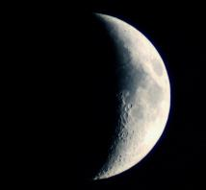

Did the flood bring about a yearly change?
Why does Scripture not record precious lives by NON EQUALLY DIVISABLE lunar years?
Shem - Genesis 11:10 - 13
These are the generations of Shem: Shem was an hundred years H8141old, and begat Arphaxad two years {shaneh H8141} AFTER THE FLOOD.
And Shem lived after he begat Arphaxad five hundred yearS, H8141 and begat sons and daughters.
And Arphaxad lived five and thirty yearS, H8141 and begat Salah:
And Arphaxad lived after he begat Salah four hundred H8141 and three yearS, H8141 and begat sons and daughters.

Slide 67
13
Note:
Why has the number 400 revealed an H8141 number when it does not indicate a direct connection to a specific year?
And Arphaxad lived after he begat Salah
four hundred H8141 and three yearS, H8141…
Because that number is PERFECTLY DIVISIBLE by another number without leaving a remainder of any kind!

Slide 68
Note:
The number
cannot, nor ever will be an
H8141 number! NEVER!
13

Slide 69


#13 - Is it - H8141? - Divisible Evenly?
/2 = 6 (+1 remainder!)
/3 = 4 (+1 remainder!)
/4 = 3 (+1 remainder!)
/5 = 2 (+3 remainder!)
/6 = 2 (+1 remainder!)
/7 = 1.857142857142…
13

Slide 70

Will the Scriptures ever reveal a lunar affiliated worship year?
Gen 21:5 And Abraham was an hundred years ^{H8141} old, when his son Isaac was born unto him.
The M/C.C. was recorded as timing the very birth of Isaac, the beginning of the Hebrew nation – Gen 17:21- Shaneh - H8141.
.
100 years that contained an EVEN NUMBER of months! Does that mean the Scriptures do not count the 33.3 years that might have contained a 13th lunar month?
Is Scripture purposely hiding the idea that Abraham was actually 133.3 years old?

Slide 71
Was the Birth of Isaac timed by a Lunar year?
Gen 18:1 – And Yahuah appeared to
him (Abraham) by the terebinth trees
of Mamre…
Gen 18:6-8 Abraham hurried to
prepare cakes of unleavened FINE
flour (wheat), curds, milk and a
chosen sacrificed calf.
Might this look like Abib 14 to you? ☺
Gen 18:10 – And He [Yahuah] said
“I shall certainly return to you
according to the time of life, and
see, Sarah your wife is to have a
son! …
The word “life” is H2416 chai.
The word “time” is H6256 eth.
Contextually and by definition
“eth” has the meaning of
- a fit or proper time, an opportunity, time (of an event).

Slide 72
Birth of Isaac (The Hebrew nation) on a Lunar year?
H2416 chai has definitions of-
living, alive
green (of vegetation)
flowing, fresh (of water)
lively, active (of man)
reviving (of the springtime)
Do these definitions align with the appearance of an Abib 14 Appointed Time observance by Abraham?
What did Yahuah proclaim next?
Gen 18:14 – Is any matter too hard for [Yahuah]? At the appointed time [H4150 Mo-ed] I am going to return to you, according to the time of life, and Sarah is to have a son.
Note: By 3 highly specific words –
1. Mo-ed [“appointed”]
2. eth & [“time of”]
3. chai [“life”]
Yahuah declared He would return
at an extremely qualified time!

Slide 73
The Mazzaroth & the Moon - a SPIRITUAL LIGHT presence?
3 Witnesses to Abraham’s {Shaneh} years that can be divided equally without any remainders left over!
Did Abraham live out ANY lunar based years? Years where the months cannot be divided evenly without there being a month left over? (A 13th Month?)
Gen 25:7 And these are the days of the years ^{H8141} of Abraham's life which he lived,
an hundred threescore
and fifteen ^{H8141} years ^{H8141}.

Slide 74


Abraham’s Life - Years –
are they Divisible Evenly?
- an hundred threescore and fifteen ^{H8141} years. ^{H8141}
175 years ! - H8141- Shaneh?
175 ÷ 7 = 25
NO REMAINDER!
NO
13

Slide 75

Yitshaq & Ya’aqov?
Yes –– Yitshaq (Isaac) lived – H8141 Shaneh years ! Genesis 25:26 / 35:28
Ya’aqov (Jacob) lived according to Yahuah’s H8141
Shaneh years! Gen 47:28
Interestingly – Jacob waited for another 7
H8141 Shaneh years for Rachel!
Clearly there was no moon leading Jacob’s worship of Yahuah!
13

Slide 76
The Moon was first identified in Yoseph’s Dream.
Did Yoseph’s life consist of lunar years?
Gen 37:9 tells us that Yoseph dreamed a dream containing a moon.
The life of Yoseph –
Gen 50:26
So Joseph died, being an hundred and ten years [H8141 Shaneh] old: and they embalmed him, and he was put in a coffin in Egypt.
The context in Gen 37:9 says nothing about looking to the moon for direction of times. Yoseph being a man of Yahuah, he NEVER lived out a 13th month nor looked to the moon to determine months, years or Appointed Times.
A lunar based worship year did not exist for Yoseph!

Slide 77
Joseph dreamed about the moon in his celestial type dream. Yet the years that Joseph lived are recorded as Shaneh years. This factor shows that even though Joseph’s dream contained a moon identity, it – the moon – had zero connection with timing Yahuah’s worship year!
What about the years of famine detailed in Pharaoh’s dream?
Gen 41:1
And it came to pass at the end of two full years, ^{(H8141 Shaneh)} that Pharaoh dreamed: and, behold, he stood by the river.
Gen 41:26
The seven good kine are seven years; ^{(H8141 Shaneh)} and the seven good ears are seven years: ^{(H8141 Shaneh)} the dream is one.
Even the years of the abundance and the famine are recorded as Shaneh years that would repeat a second time.

Slide 78
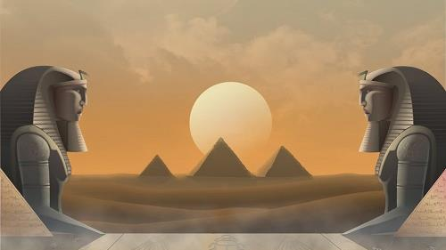

Gen 41:1 & Gen 41:26
Do you realize that these two verses have
full secular support as found in the
Mul-Apin Tablets?
12, “30 day months” & 360 cycles in ONE YEAR!
TEQUFAH TO TEQUFAH! DAWN TO DAWN!
The Wisdom of Mitsrayim!
Shaneh!

Slide 79
Joseph’s life is recorded in Shaneh years which not only duplicate by mirror image but always consecutively repeat.
Pharaoh’s life is also recorded as containing Shaneh years which repeated a second time in succession.
Did Mitsrayim (Egypt) operate on a solar or lunar based economy?

Slide 80
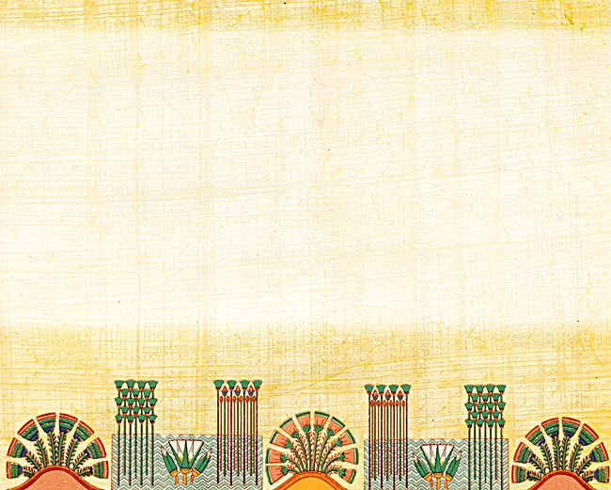

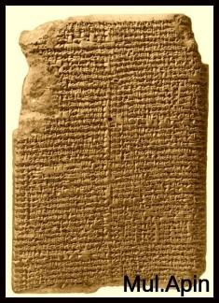
For the answer we go to the Mul Apin Tablets.
These tablets expose that - yes indeed - the economy in Mitsrayim operated on
a strict solar based year.
This type of solar based year contained - documented & dedicated 30 day months!
No more, no less.
The Lunar 29.5 day month had no place in Mitsrayim’s economy.
80

Slide 81

Who was this Pharaoh and What was his Heritage?
When Joseph lived in Mitsrayim, what kind of Pharaoh ruled the land? Was he of a pagan heritage or did he worship our Creator at one time in his life?
The Westminster Dictionary of the Bible – pg. 329. The Pharaoh who welcomed them [Jacob and his family] was doubtless of the Hyksos dynasty, and being himself a Semite, was the more ready to welcome men of a race identical with his own. With this agrees the fact that the Israelites were settled around the Hyksos capital of Egypt in the “plain of Tanis” (Zoan, Ps. 78:12, 43). The King who knew not Joseph (Exo. 1:8) and who oppressed the Israelites represents a Pharaoh who reigned after the expulsion of the Hyksos.
The Hyksos Pharaoh was a Semite!

Slide 82
The Hyksos Pharaoh was a Semite!
A descendant of Shem!
Could this be one of the miracles of how Yoseph received great favour from the Pharaoh?
Are we beginning to see how Yahuah blessed
the years of Yoseph and the Pharaoh which
were both recorded in agreement with the
Shaneh type of years?

Slide 83



OK! Let’s prepare for Part #2 ☺
Did Yahuah identify the Tequfah based year when He identified the first month of the year to Mosheh in
Exodus 12 ?
IS IT TRUE that Ezekiel revealed
a 13th month in the Scriptures?
Coming on
Jan 18, 2019!

Slide 84
May your name be found among the numbers PERFORMING his commands. Rev 22:14
May your blessings be as the stars.
Timothy Astleford Dec 31/18
The End

Slide 85
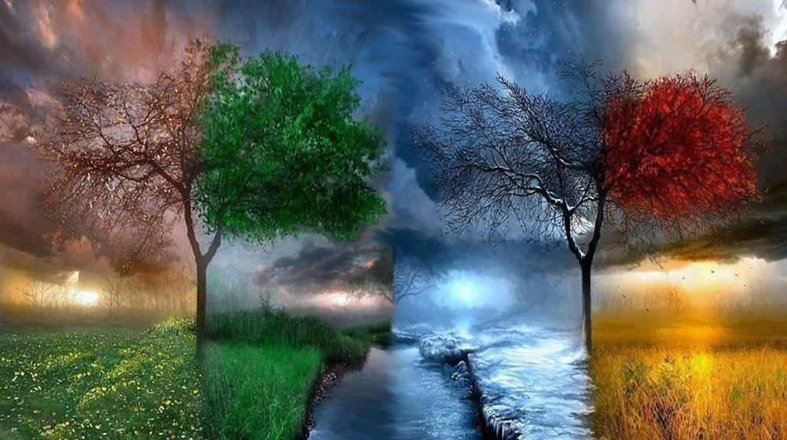

If you need assistance with this information, please send your
questions to Timothy Astleford:
tim@studythecalendar.com
www.studythecalendar.com/resources

